Slide 1

uThukela District Hospital IT Modernisation
FEINT SOVIET
LEHLOGONOLO TSHEHLA
FAHIMA PATEL
ROFHIWA MONTJANE

Slide 2
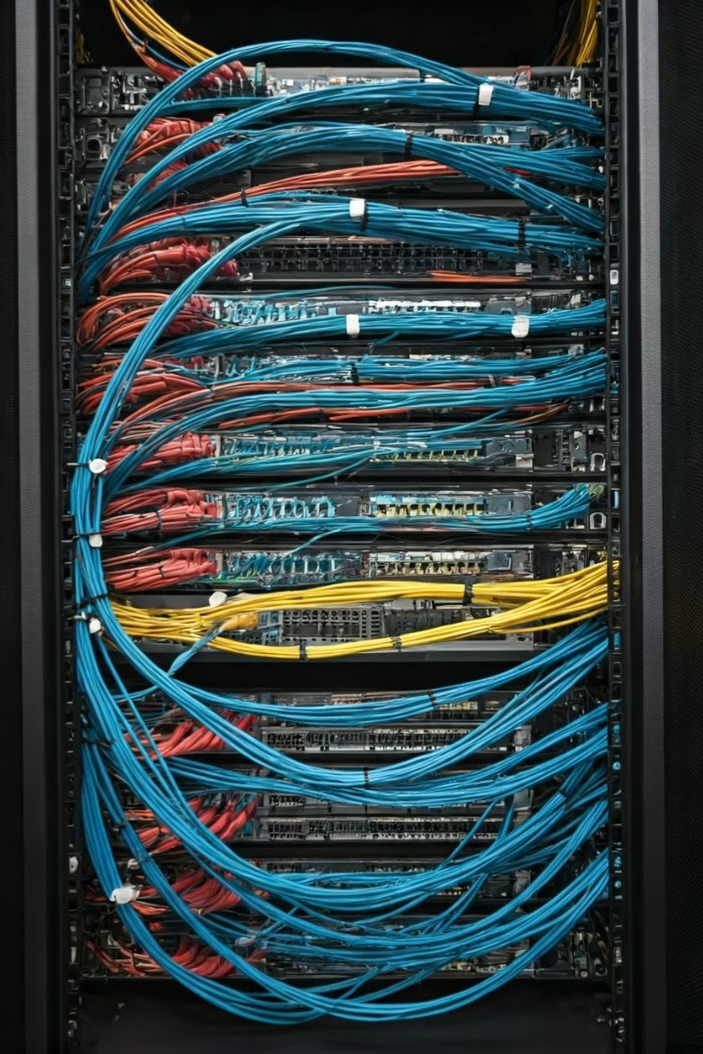
Agenda
1
Introduction
2
Challenges
Overview of the hospital's current IT environment, highlighting existing challenges and their impact.
Detailed analysis of key IT issues affecting patient care, operations, and data security.
3
Solutions
4
Conclusion
Recommended IT upgrades, security enhancements, and data management improvements.
Summarize the proposed solutions and emphasize the benefits of modernization.

Slide 3
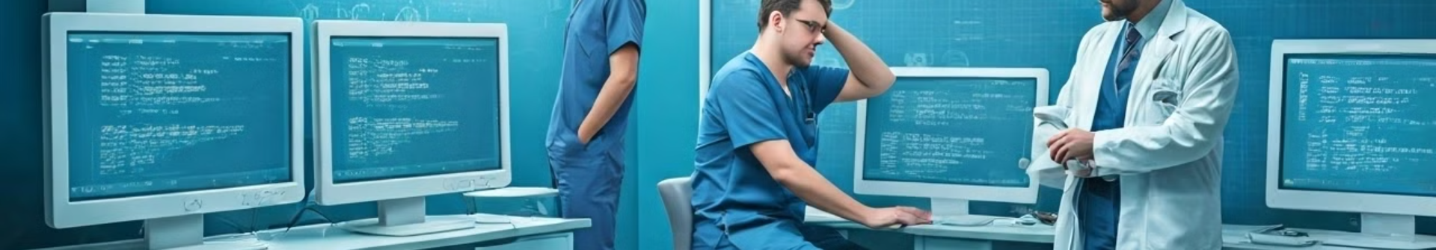
Introduction to uThukela District Hospital's IT Situation
1
2
3
4
Services Offered
Objective
Site and Scope
Carrier and Timeline
Hospitals provide essential services including patient treatment, surgery, and diagnostic services like lab tests and imaging. Also, preventive health services, rehabilitation, and patient education to support overall community health.
The uThukela District in KwaZulu-Natal seeks a network infrastructure to deliver fast and reliable internet to its main hospital in this remote region through fiber connections.
The hospital employs 2,000 medical, admin, contactor staff and has 5 ICT support staff and serves 100 patients daily. They have 20 PCs, 5 Printers and has cases of missing patient files. Overall it’s comprised of 45 Wards and 5 offices.
Openserve has been selected as the network carrier, with the entire infrastructure rollout planned for completion within one year.

Slide 4
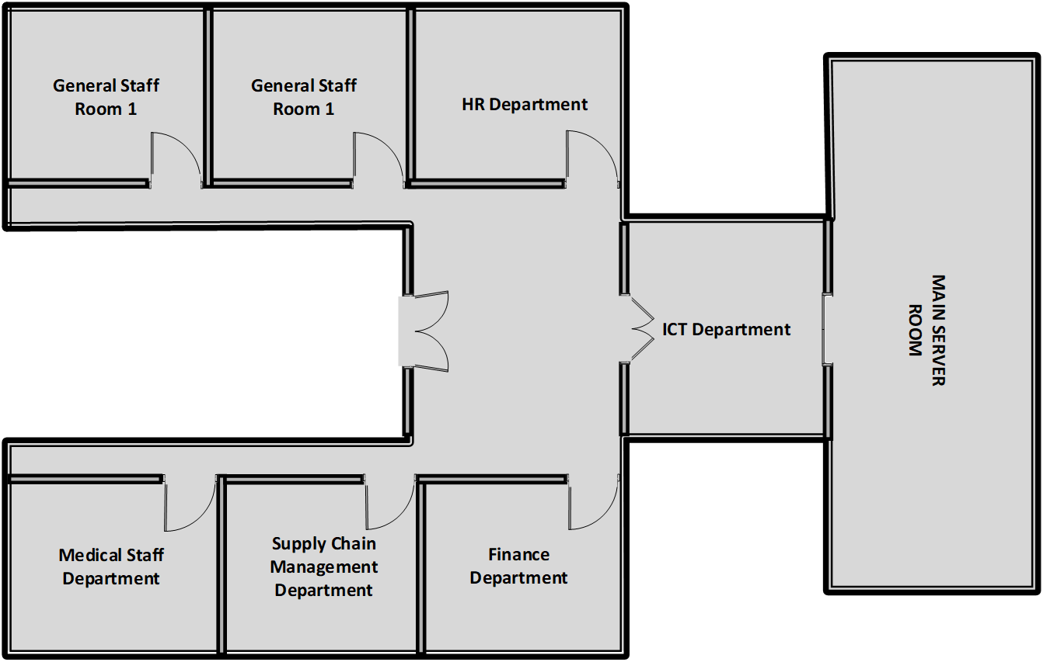
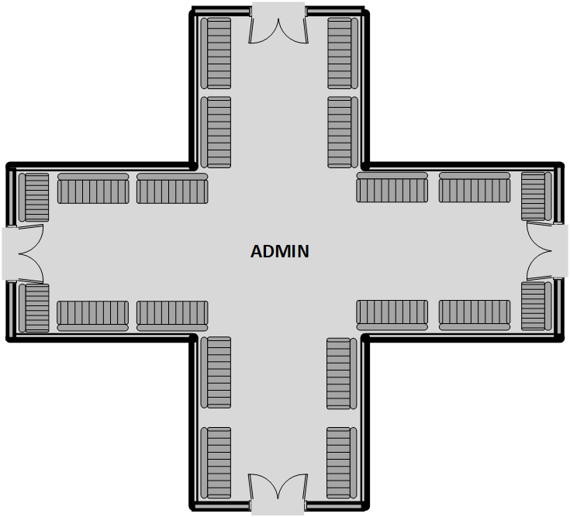
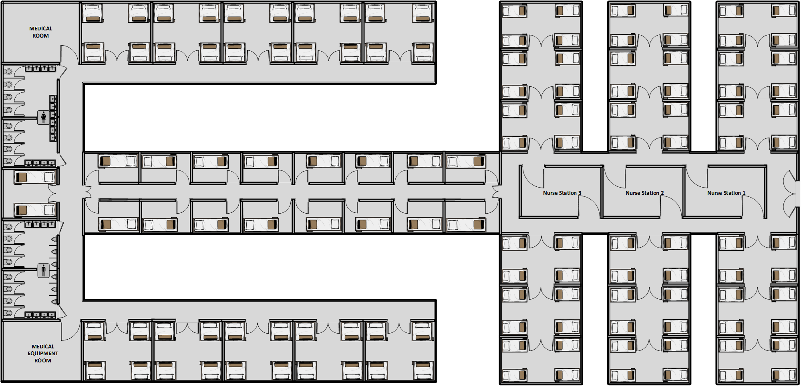

Slide 5

IT Challenges
Outdated Infrastructure
Limited Network Capacity
Security Vulnerabilities
Aging hardware leads to slow performance and frequent breakdowns, disrupting critical operations.
Limited bandwidth restricts data transfer speeds, impacting real-time access to patient information.
Insufficient security measures expose sensitive patient data to potential cyberattacks.

Slide 6




IT Solutions and Changes
Data Management Upgrades
Integration
Hardware Upgrades
Dynamics 365
Replace outdated servers and workstations with modern equipment like computers with the latest CPU and GPU chips for more efficiency.
Centralized Data Repository
Consolidate patient data into a secure, centralized system for easy access and analysis.
Security Enhancements
Implement advanced security measures such as firewalls and authentication tools to protect patient data and hospital systems to prevent any unauthorized access.
Seamless Data Flow
Cloud-Based Solutions
Unified platform for managing patient records, billing, and hospital inventory.
Leverage cloud computing for scalability, cost-efficiency, and remote access to data.
Staff Training
Enables data sharing between departments for improved communication and coordination of care.
Develop comprehensive training programs to ensure staff competency in using the new IT systems.
Cloud-based, providing remote access for authorized personnel, improving mobility and accessibility.
Data Analytics and Reporting
Implement data analytics tools to gain insights from patient data for improved healthcare delivery.
Integration with diagnostic tools, financial systems, and supply chain management.

Slide 7



OLD INFRASTRUCTURE DATA
Hardware & Network Upgrades
45%
Wi-Fi 6 Deployment
4
Implement Wi-Fi 6 access points for improved wireless connectivity throughout the hospital.
Server Replacement
56%
1
Upgrade to high-performance servers to handle increased workloads and data storage.
PERFORMANCE
Next-Generation Firewalls
Deploy advanced firewalls to detect and block malicious traffic.
LATENCY
5
Network Infrastructure Enhancement
2
Expand network capacity with high-speed routers and switches for faster data transfer.
End-to-End Encryption
6
Implement strong encryption protocols to protect sensitive patient data in transit and at rest.
Multi-Factor Authentication (MFA)
Require multiple authentication factors to prevent unauthorized access to systems.
Role-Based Access Control
3
Grant users access only to the data and systems they need for their roles.
7
55%
DATA SECURITY

Slide 8
NEW INFRASTRUCTURE DATA
13%
82%
LATENCY
PERFORMANCE
90%
DATA SECURITY

Slide 9

Staffing and Training
Increase IT support staff to meet the hospital’s needs.
Provide regular training for all staff on new IT systems.
Establish a help-desk to assist staff with technical issues.
Continuous training on cybersecurity best practices.

Slide 10
Conclusion
By investing in IT modernization, uThukela District Hospital can improve patient care, enhance operational efficiency, and ensure data security.
Visit us on : https://github.com/pfahima/WIL_PROJECT2024

